Slide 1
Data Inceptionists
Frank Liu, Ryan Cambell

Slide 2
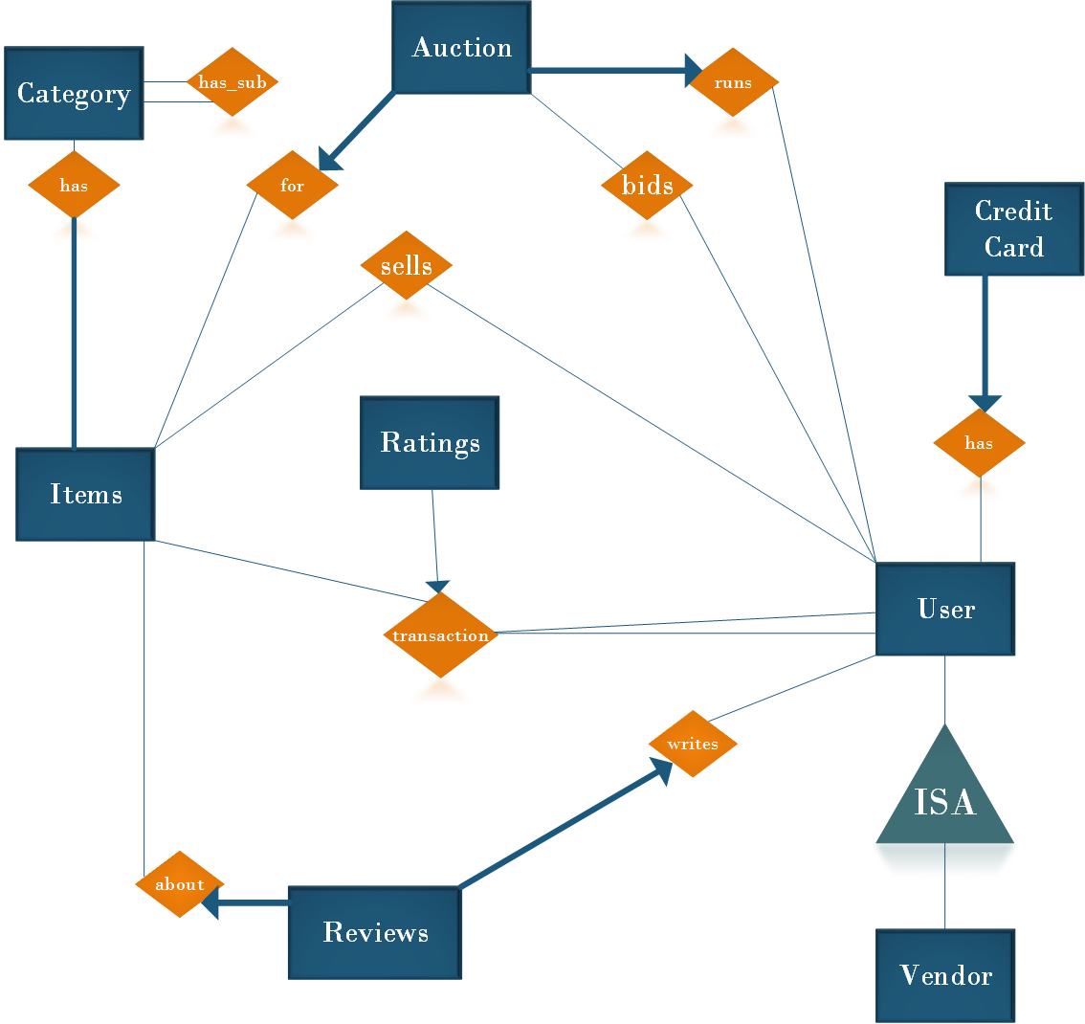
Overview

Slide 3
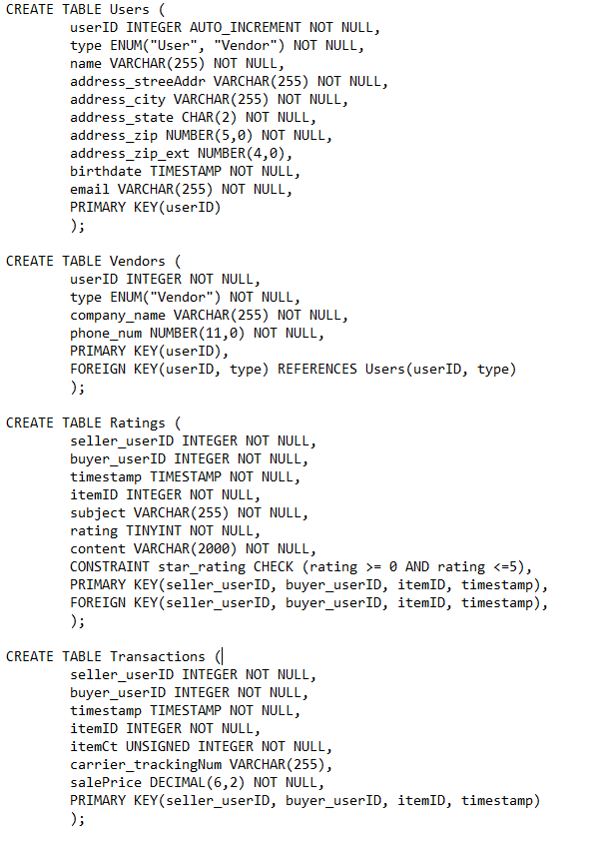
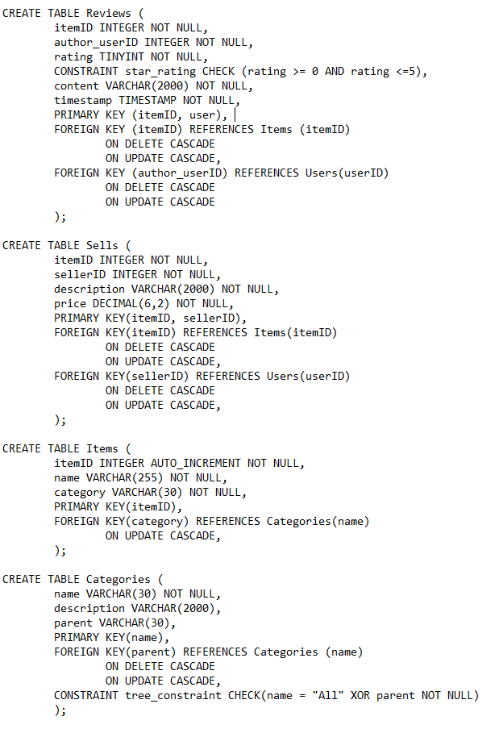
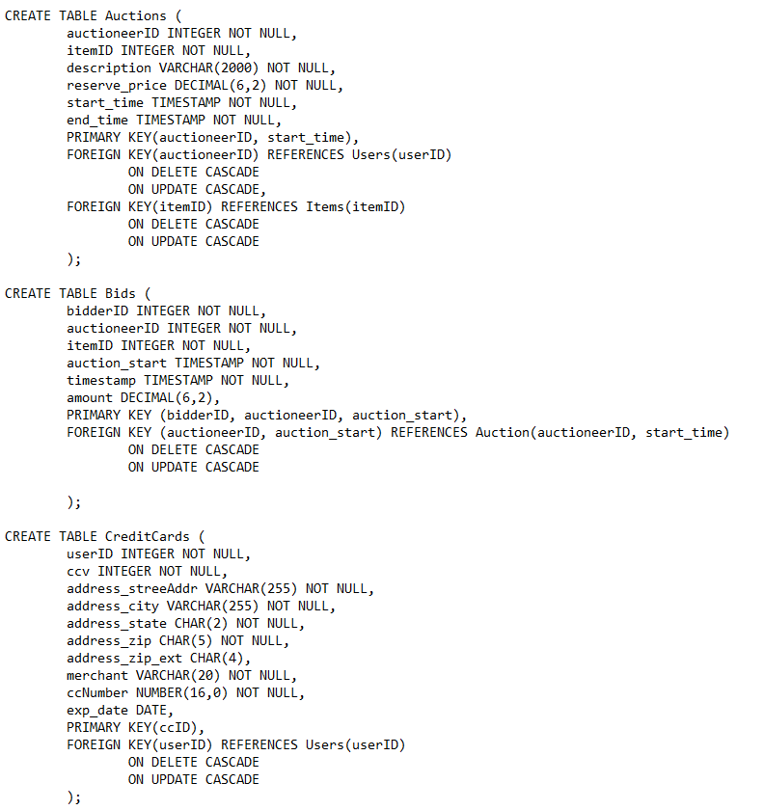
Final Schema

Slide 4
User Types

Slide 5
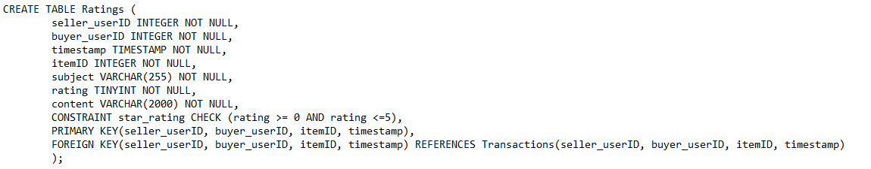
Reviews/Ratings

Slide 6
Items and their Categories

Slide 7
Auctions and Bids

Slide 8
Credit Cards

Slide 9
Planned Implementation Tools
MySQL:
Free
Easy to use
Scales very poorly
Java(for the backend):
Familiarity
Integrates well with web
Prepared Statements:
Faster than using regular SQL queries
Defends against SQL injection
Python/Ruby (frontend scripting):
Easier than javascript/php
FedEx/UPS APIs:
Generate labels automatically to make shipping easier for users

